Slide 1
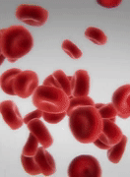
Blood
AEHBY ATAR Human Biology

Slide 2
Review
Vijay has a resting heart rate of 70bpm and a stroke volume of 65mL. Determine Vijay’s cardiac output.
List the tissues you would find in the circulatory system and where they would be found.
Explain the difference between competitive and non-competitive enzyme inhibitors.
Give an example of an anabolic reaction and a catabolic reaction that occurs in human cells.

Slide 3
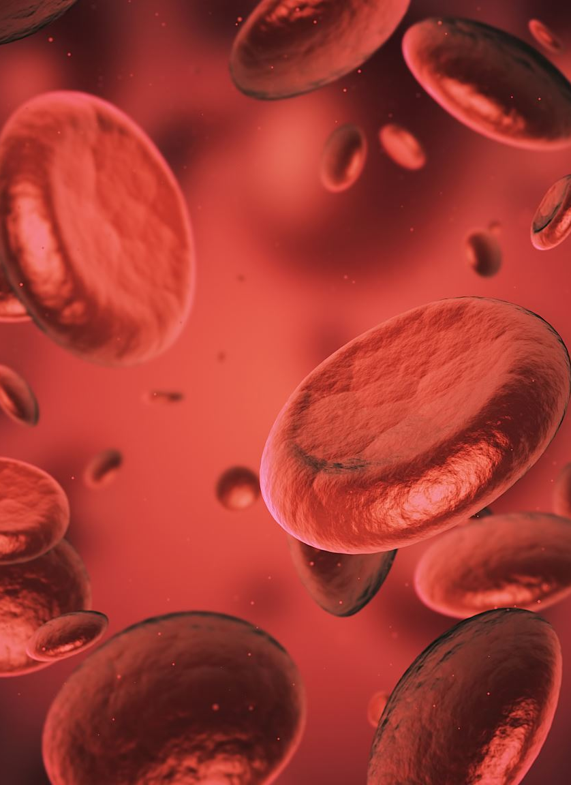
Learning Intentions
The components of blood facilitate the transport of different materials around the body (plasma and erythrocytes), play a role in the clotting of blood (platelets) and the protection of the body (leucocytes).

Slide 4
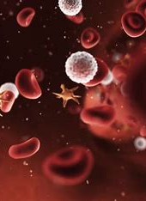
Success Criteria
List/describe the components of blood (percentages)
Describe different types of white blood cells
Explain how clotting occurs
Describe how O₂, CO₂, nutrients and wastes are carried

Slide 5
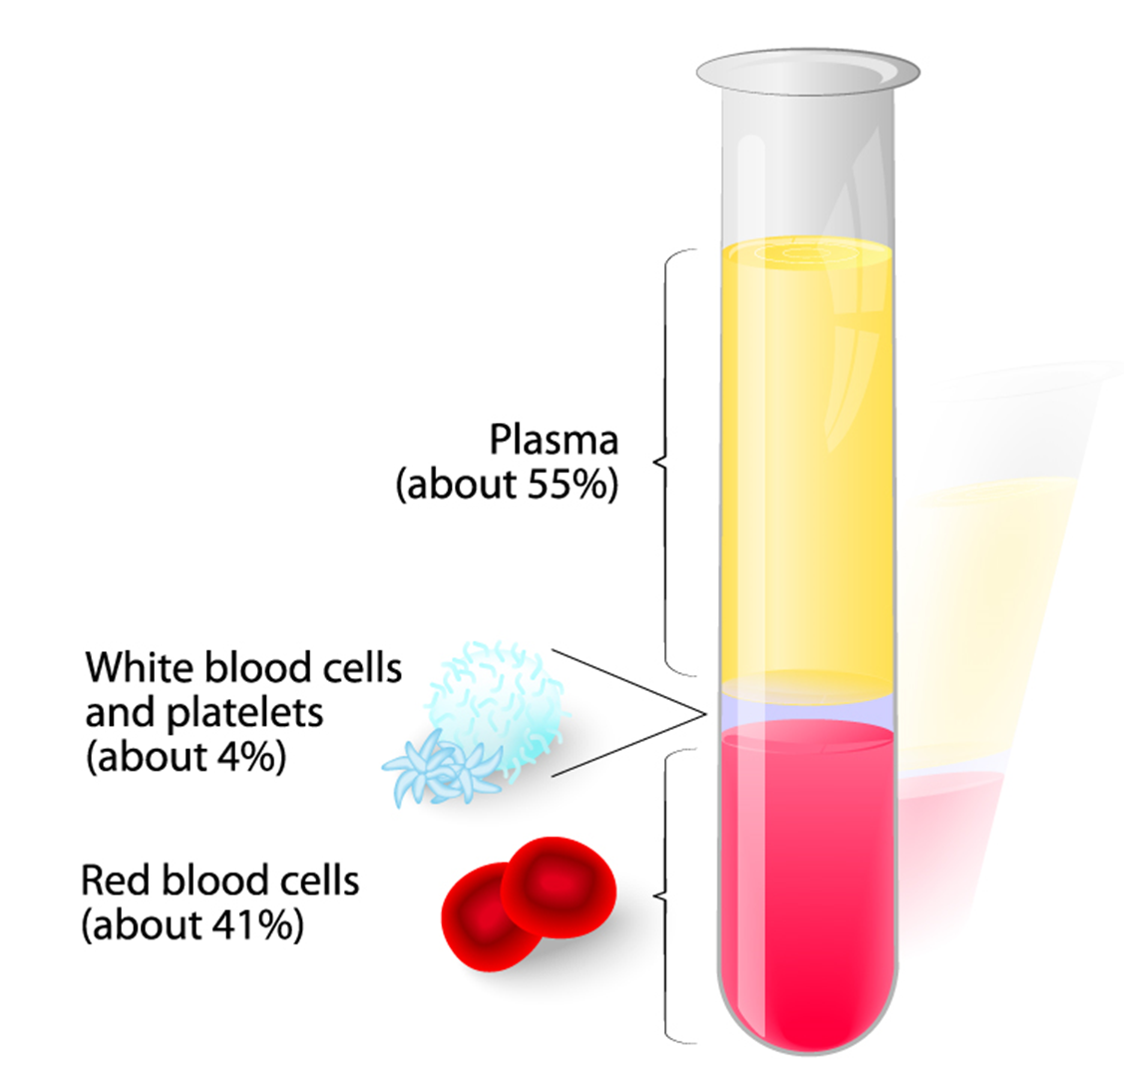
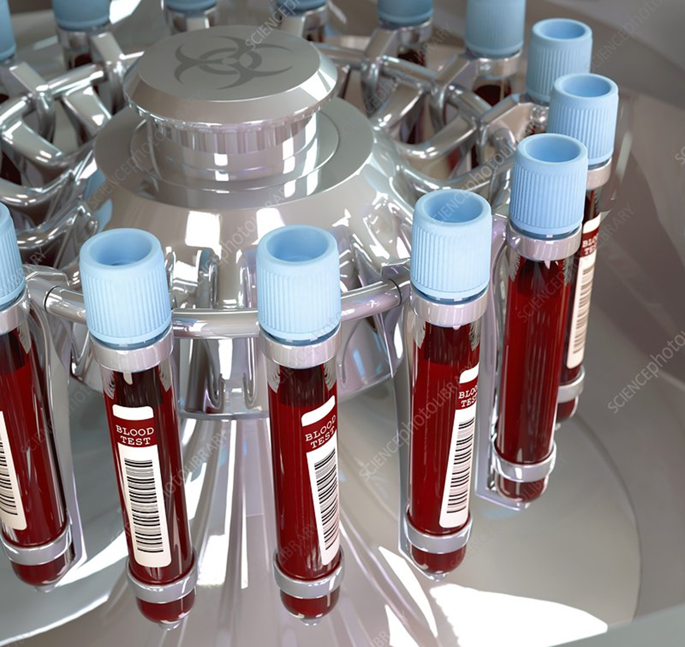
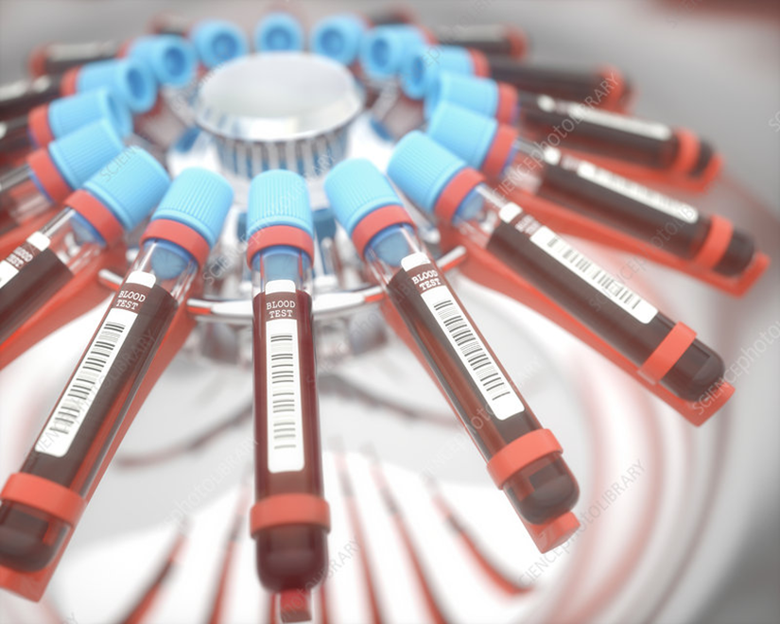
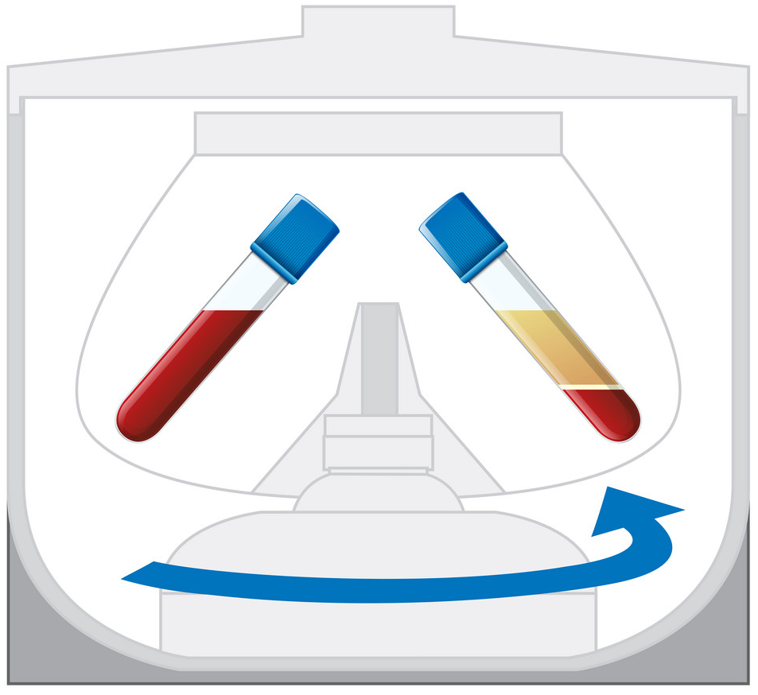
Composition of blood

Slide 6
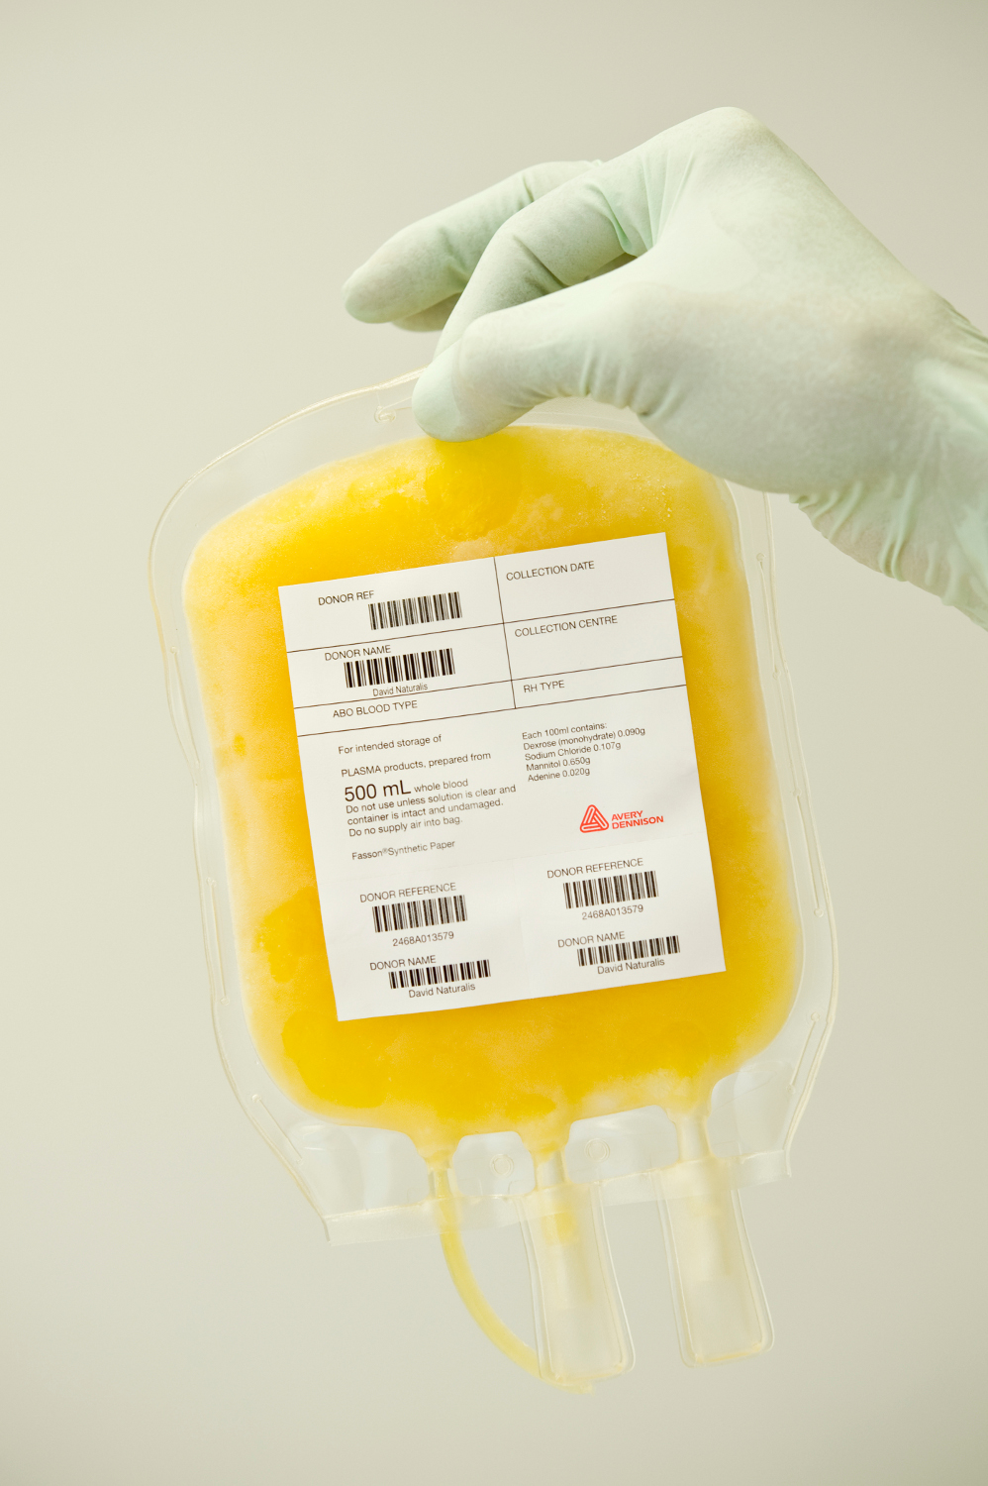
Plasma(55%)
Water with dissolved sugars, salts, proteins and gases.
Transports cell components, nutrients, wastes, hormones, proteins, antibodies, heat and water throughout the body.

Slide 7
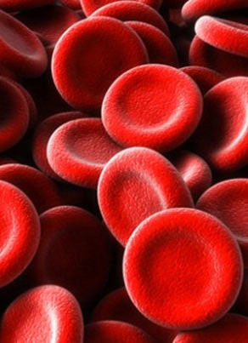
Erythrocytes (red blood cells) (40-45%)
Biconcave cells with no nucleus (increases surface area and flexibility)
Contain haemoglobin which carries O2.

Slide 8
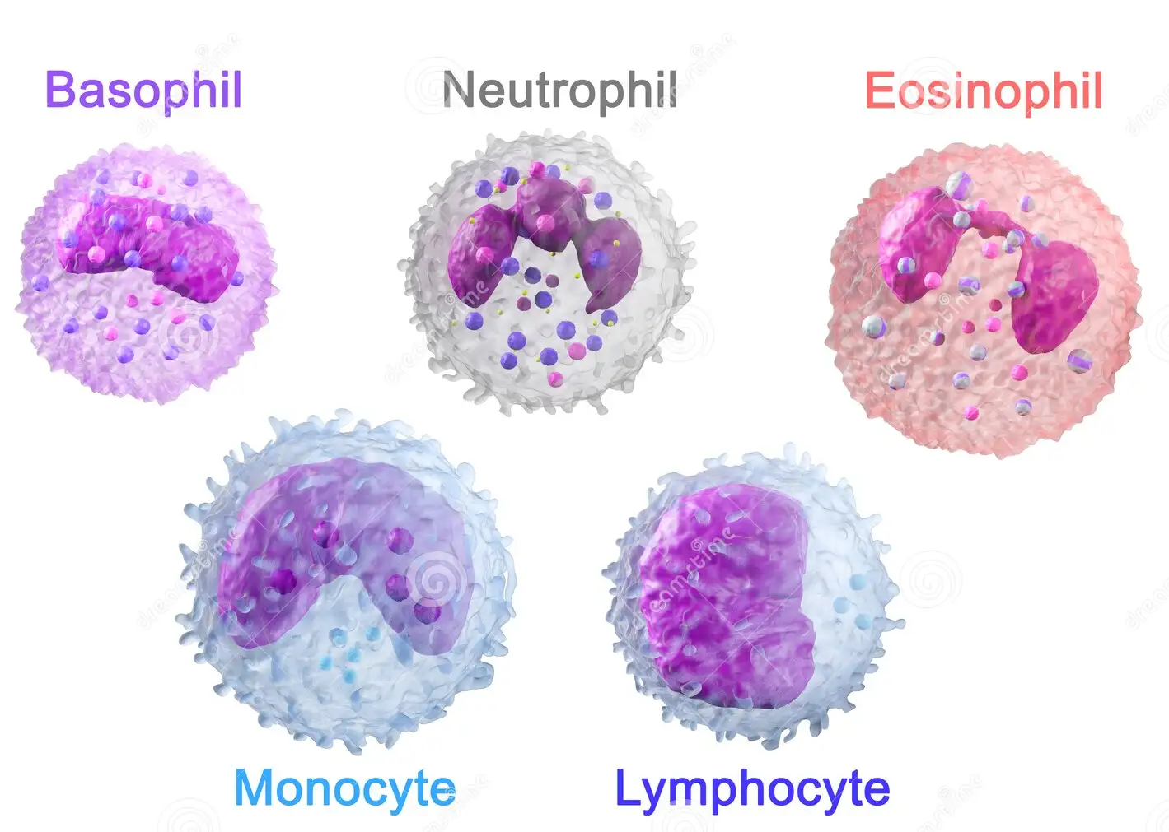
Leucocytes (white blood cells) (1%)
Protect body from infection
Neutrophils – contain enzymes to digest pathogens
Monocytes – engulf pathogens or damaged/old cells
Lymphocytes – cell/antibody mediated immune response
Basophils – produce chemicals to defend against small pathogens
Eosinophils – lead to inflammatory response against large pathogens

Slide 9
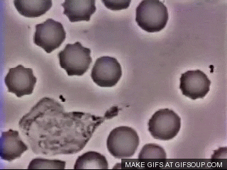

Slide 10
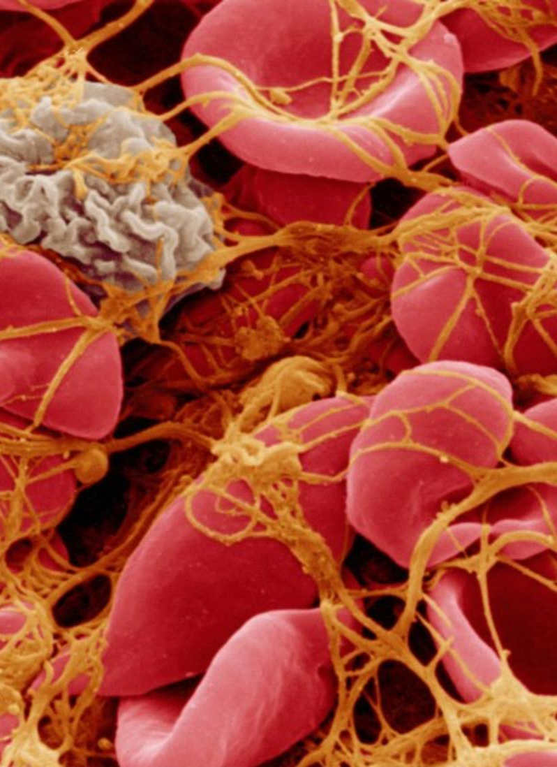
Thrombocytes (platelets) (3%)
Small cell fragments.
Assist with clotting when a blood vessel is damaged.

Slide 11
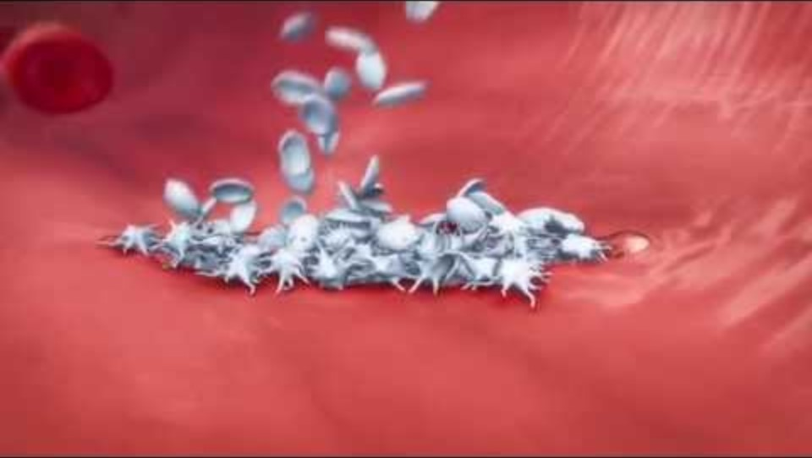

Slide 12
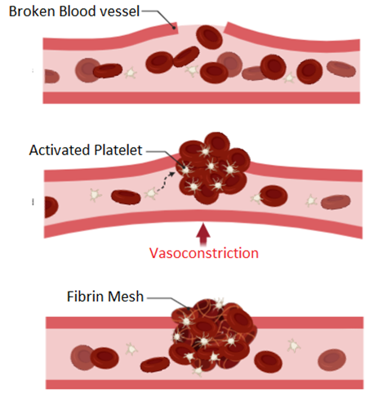
Clotting sequence
Vasoconstriction
Platelet plug
Coagulation

Slide 13
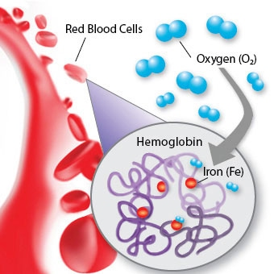
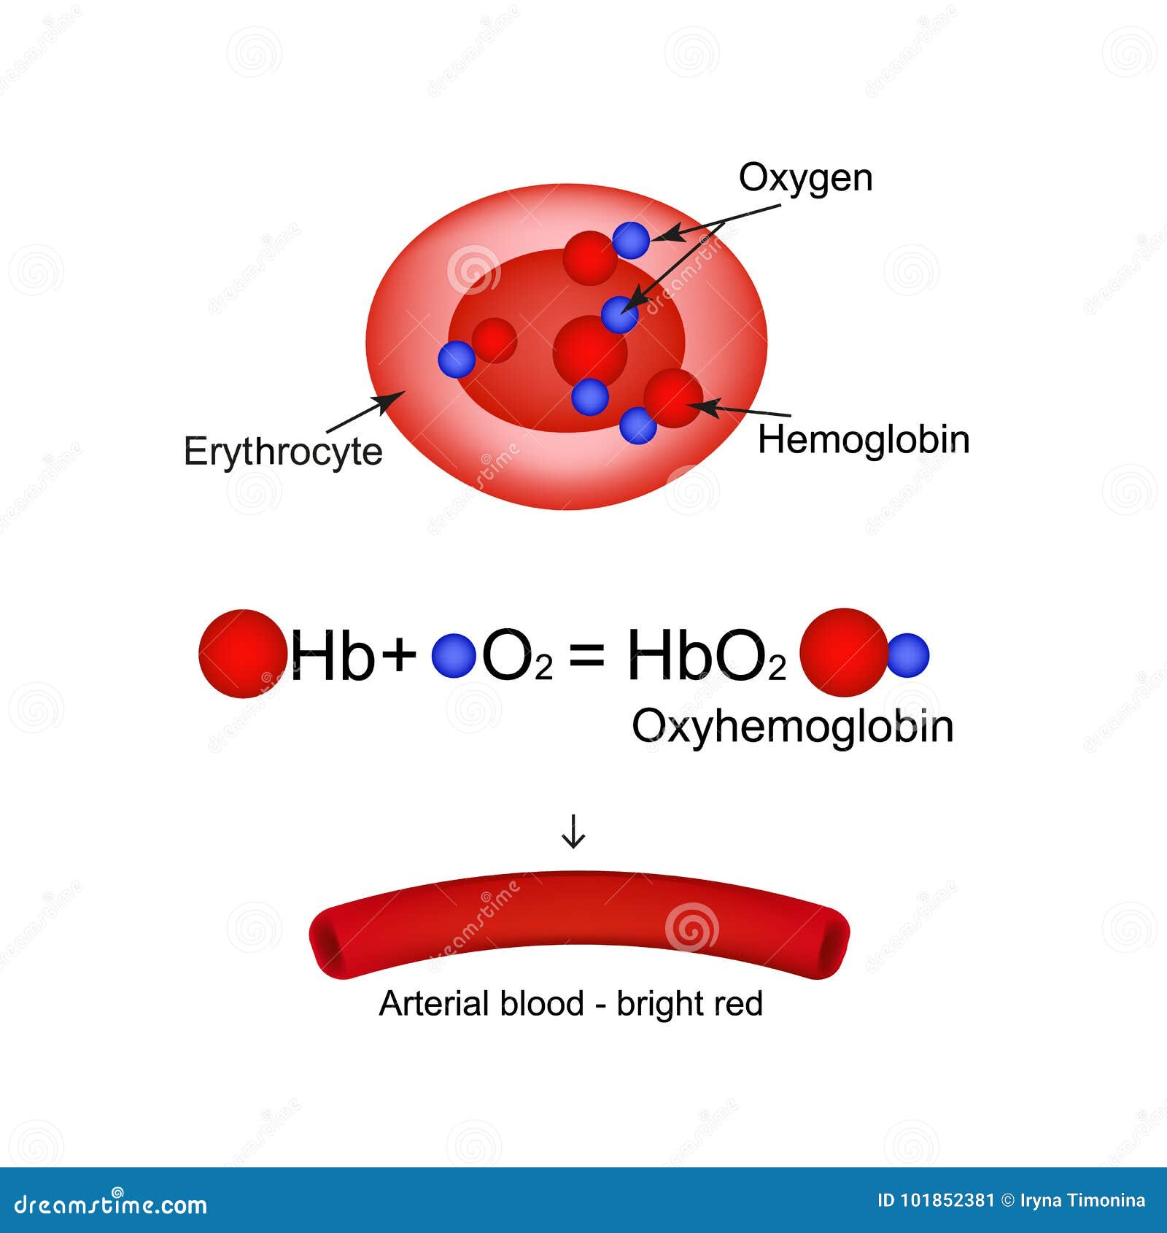

Functions of blood
Oxygen in carried dissolved in plasma (3%) or combined with haemoglobin molecules (97%).

Slide 14
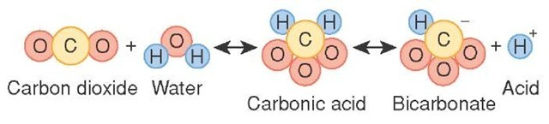
Functions of blood
Carbon dioxide is carried in solution (7-8%) attached to haemoglobin (22%) or as part of the bicarbonate ion HCO₃⁻ (70%)

Slide 15
Functions of blood
Nutrients (eg glucose, vitamins, amino acids, fatty acids, glycerol and salts such as Na⁺, Ca⁺², K⁺, Cl⁻ and I⁻)
and wastes (eg urea, creatinine and uric acid) are carried dissolved in plasma.

Slide 16
Success Criteria
List/describe the components of blood (percentages)
Describe different types of white blood cells
Explain how clotting occurs
Describe how O₂, CO₂, nutrients and wastes are carried

